Slide 1
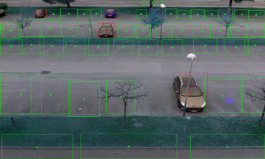

Smart Parking Lot

Slide 2
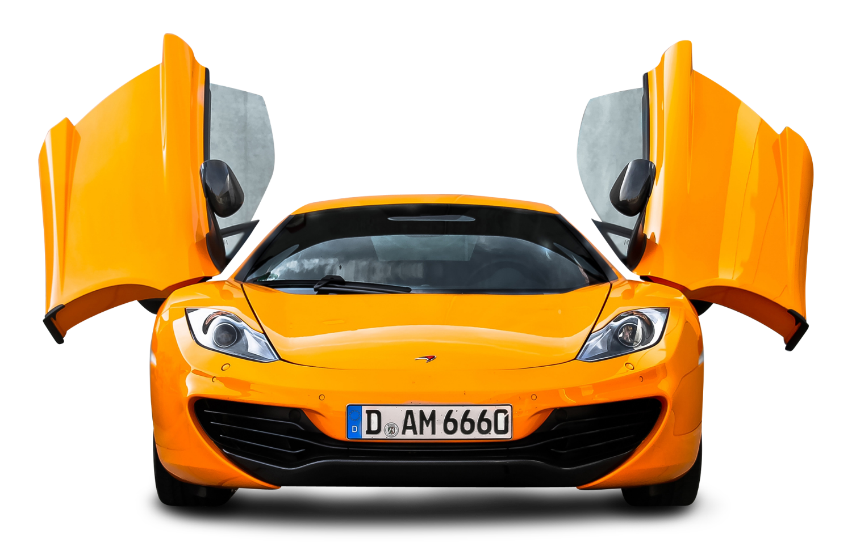
content
Topic
Why we Selected our topic
How we implemented
Related works and repository
Outcomes and result analysis
Experiments

Slide 3
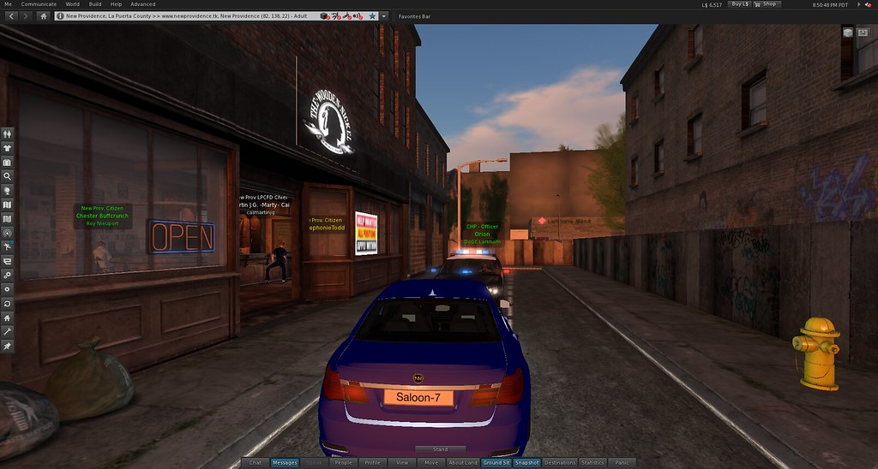
Topic
Smart parking System

Slide 4
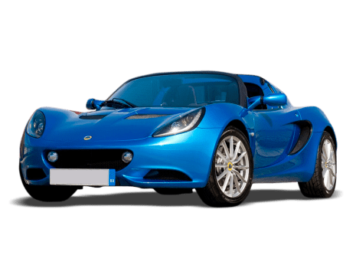
Why we Selected our topic
Traditional Car Parking Problems Faced By Drivers
Cost , Time Efficient Solution
security purpose

Slide 5
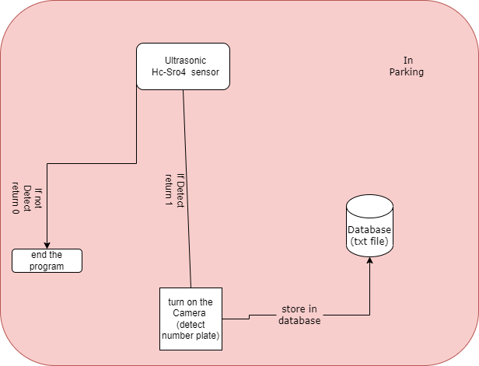
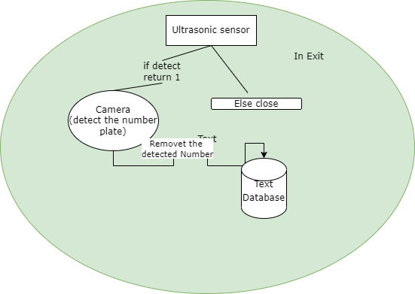
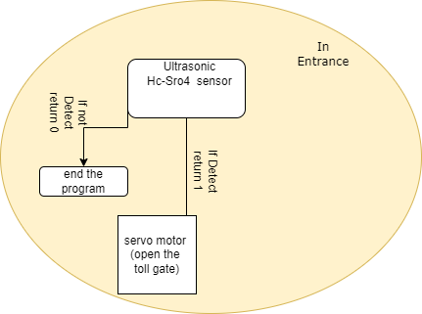
How we implemented with 3 raspberry

Slide 6
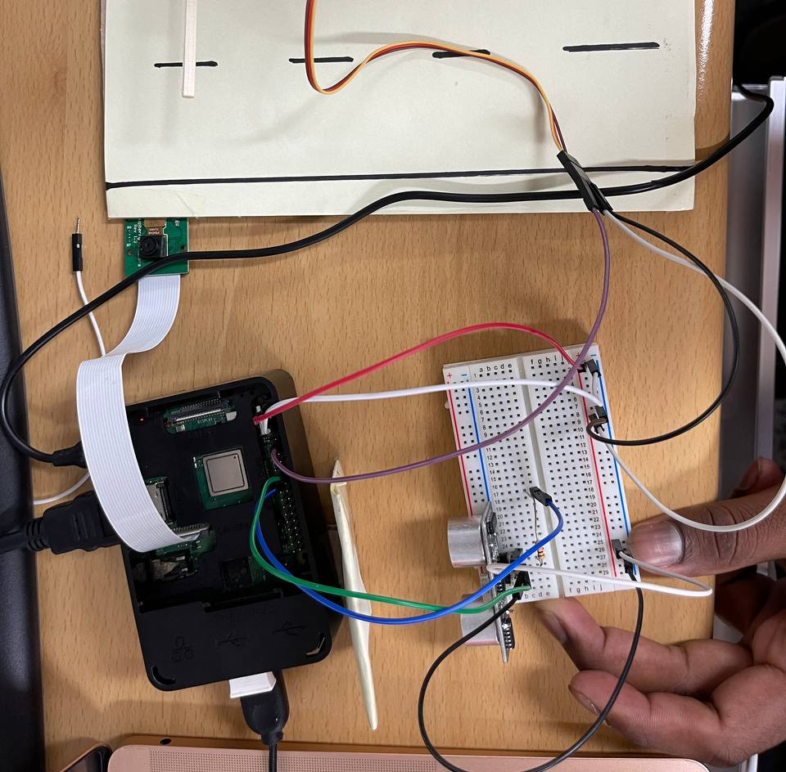
We detect vehicle
We use ultrasonic hc-sro4 sensor to detect vehicle distance and return the distance and if distance is < 10cm it return 1 and it will start servo motor 9g and it moves 90 degree. After 5s it will come back to 0 degree.

Slide 7
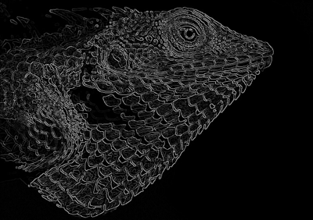
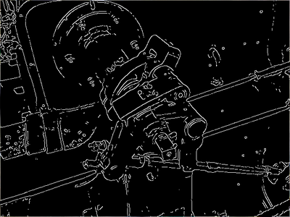
How we capture Number plate
Using python libraries implementing a canny edge detection method
From that detecting the number plate.

Slide 8
The contour function will be used to detect the rectangular objects in the image to find the number plate.
Character Segmentation. (Once Contour detects the License Plate, we have to crop it out and save it as a new image)
Character Recognition.
Character Segmenta
edged = cv2.Canny(gray, 30, 200) #Canny Edge Method
https://indiantechwarrior.com/canny-edge-detection-for-image-processing/#:~:text=Canny%20edge%20detection%20uses%20linear,process%20called%20non%2Dmaximal%20suppression.
gray = cv2.cvtColor(image, cv2.COLOR_BGR2GRAY) #convert to grey scale
gray = cv2.bilateralFilter(gray, 11, 17, 17) #Blur to reduce noise

Slide 9
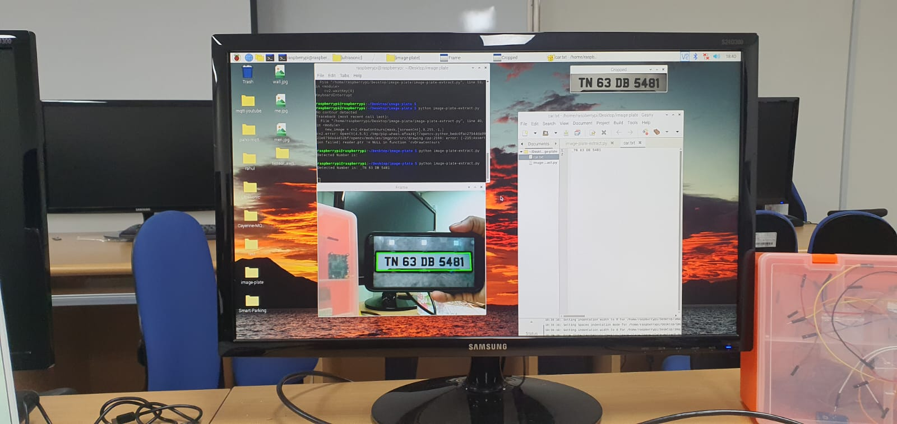

Slide 10
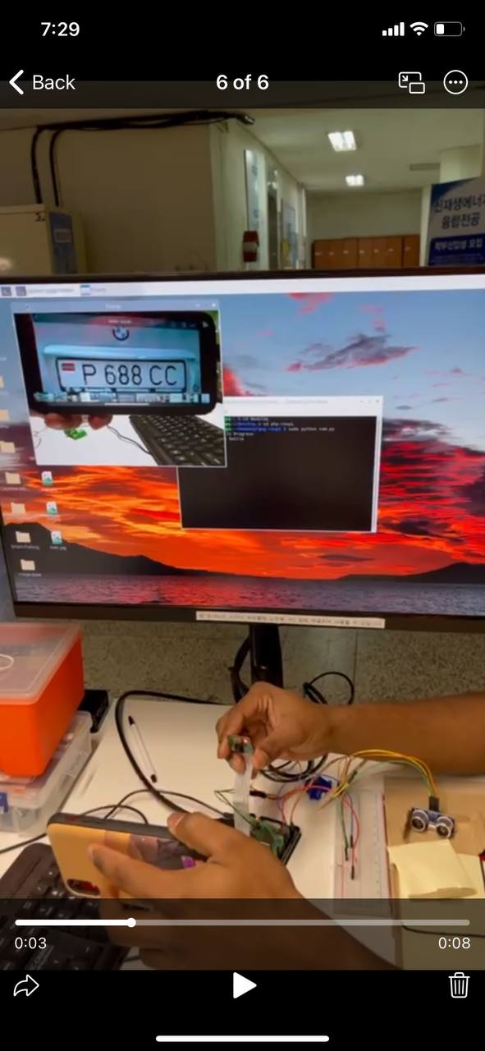

Slide 11
File handling – chap II
file=open('car.txt',’a')
for line in file:
for word in text:
line = line.replace(text, "")
file.write(line)
file.close()
file=open('car.txt','a')
file.write('/n')
file.write(text)
file.close()
Using Append method

Slide 12
Storing String into txt file using python file handling
We use append method of python and appending numbers to file system
Once it detect from exit side camera it will remove existing string from file

Slide 13
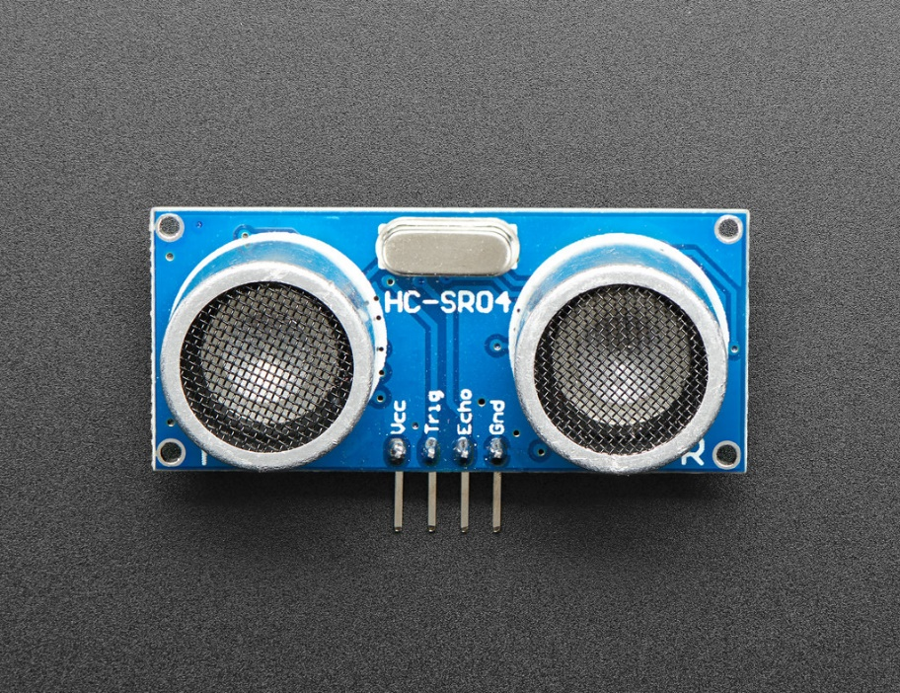

Experiments
Try to display empty parking slots to public using cayenne but unfortunately couldn’t fulfill that one.

Slide 14

Related works and repository
A Research on Improved Canny Edge Detection Algorithm (Jun Li1 and She)
International Journal of Computer Applications (0975 – 8887)Volume 69– No.9, May 201321Automatic Number Plate Recognition System(ANPR): A Survey
Smart Parking Systems and Sensors: A SurveyG. Revathi1, V. R. Sarma Dhulipala

